Slide 1



Eye-Tracking Analysis with Deep Learning Method
ARCHANA K (21MCR008)
ARUN HIRUTHIK K P (21MCR009)
DINESH KUMAR P (21MCR022)
GUIDE
Dr. M. PYINGKODI,
Dr. T. M. SARAVANAN
Department of Computer Applications,
Kongu Engineering College.
Perundurai-638052
Notes:
1 November 2022

Slide 2
AGENDA
Introduction
About project
Convolutional Neural Network
Image augmentation
Gray scaling
Plot and accuracy
Final output

Slide 3
INTRODUCTION
Nowadays teenager’s and college students are at an increased risk for developing an addiction to drugs or alcohol.
This might cause great damage for the future generation.
To develop and compare deep learning (DL) algorithms to detect drug usage by eye tracking methods.
12/29/2018

Slide 4
ABOUT PROJECT
The eye of a drugged person differs from the eye of a normal person.
As we can use two types of datasets, like drug-user eye images and non-drug-user eye images.
To take a high-quality image as an input.
The image changed to a histogram (binary value). Iris's part is not considered in the results.
White equals 0 and black equals 1. White is higher than black, which is not drugged, Black is higher when it is drugged.

Slide 5
CONVOLUTIONAL NEURAL NETWORK
A convolutional neural network (CNN or ConvNet) is a network architecture for deep learning that learns directly from data.
CNNs are particularly useful for finding patterns in images to recognize objects, classes, and categories.
They have three main types of layers, which are:
    Convolutional layer.
    Pooling layer.
    Fully-connected (FC) layer.

Slide 6
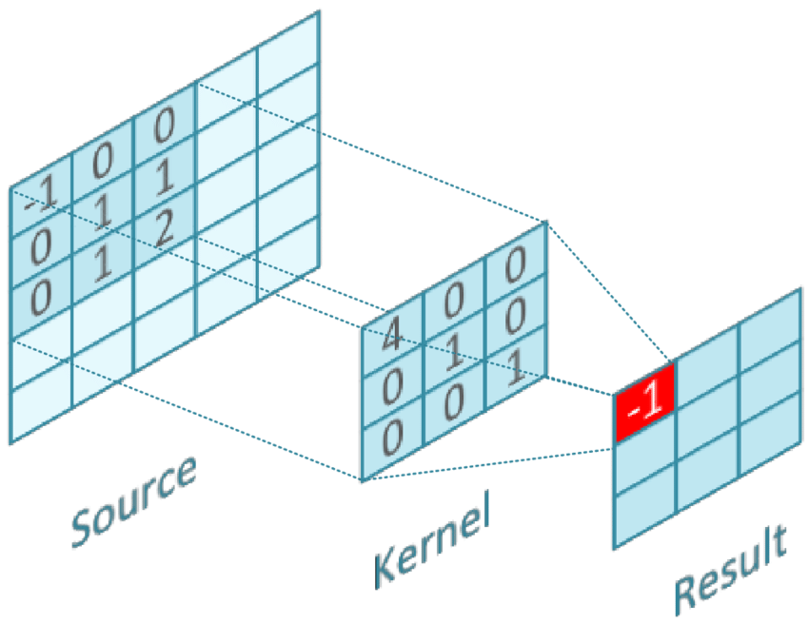
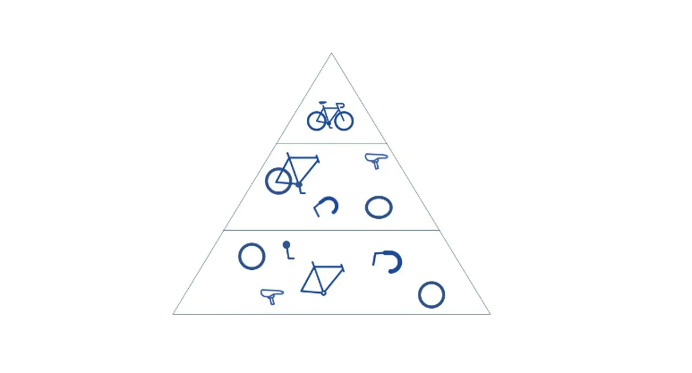
CONT.,
CONVOLUTIONAL LAYER
  The convolutional layer is the core building block of a CNN, and it is where the majority of computation occurs. It requires a few components, which are input data, a filter, and a feature map.
  The convolutional layer converts the image into numerical values, allowing the neural network to interpret and extract relevant patterns.

Slide 7
CONT.,
POOLING LAYER
  Pooling layers, also known as down sampling, conducts dimensionality reduction, reducing the number of parameters in the input.
  Similar to the convolutional layer, the pooling operation sweeps a filter across the entire input, but the difference is that this filter does not have any weights.
  There are two main types of pooling:
    Max pooling
    Average pooling

Slide 8
CONT.,
POOLING LAYER
  Max pooling - As the filter moves across the input, it selects the pixel with the maximum value to send to the output array. As an aside, this approach tends to be used more often compared to average pooling.
  Average pooling - As the filter moves across the input, it calculates the average value within the receptive field to send to the output array.

Slide 9
CONT.,
FULLY CONNECTED LAYER
  The name of the full-connected layer aptly describes itself. As mentioned earlier, the pixel values of the input image are not directly connected to the output layer in partially connected layers.
  However, in the fully-connected layer, each node in the output layer connects directly to a node in the previous layer.
  FC layers usually leverage a softmax activation function to classify inputs appropriately, producing a probability from 0 to 1.

Slide 10
IMAGE AUGMENTATION
We used the eye image dataset to predict whether or not the person is drugging.
Image augmentation artificially creates training images through different ways of processing or combination of multiple processing, such as random rotation, shifts, shear and flips, etc.
An augmented image generator can be easily created using ImageDataGenerator API in Keras. ImageDataGenerator generates batches of image data with real-time data augmentation.

Slide 11
GRAY SCALING
Grayscale is a range of shades of gray without apparent color. The darkest possible shade is black, which is the total absence of transmitted or reflected light.
The lightest possible shade is white, the total transmission or reflection of light at all visible wavelength s.
Grayscale images, a kind of black-and-white or gray monochrome, are composed exclusively of shades of gray.

Slide 12
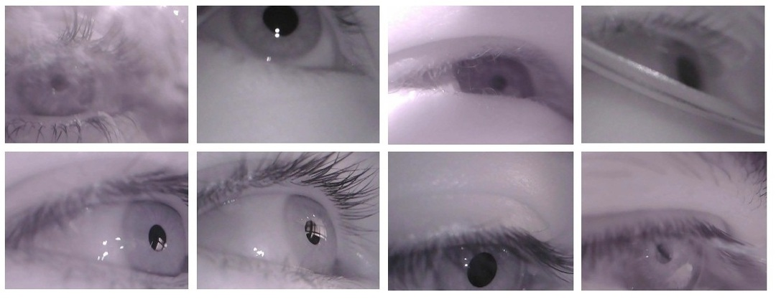
GRAY SCALING
The final accuracy of the predicted model is vey based on the images.
Most of these models need to be improved because they are based on bottom-up computation that does not consider top-down image semantic contents and often does not match actual eye fixation locations.
The results showed that it is possible to predict the eye fixation locations by using of the image patches around subjects' fixation points.

Slide 13
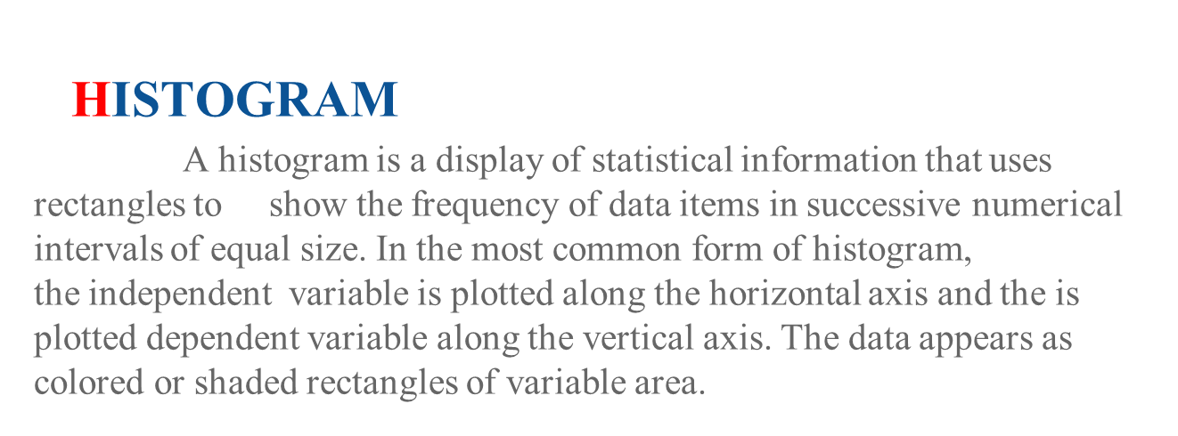
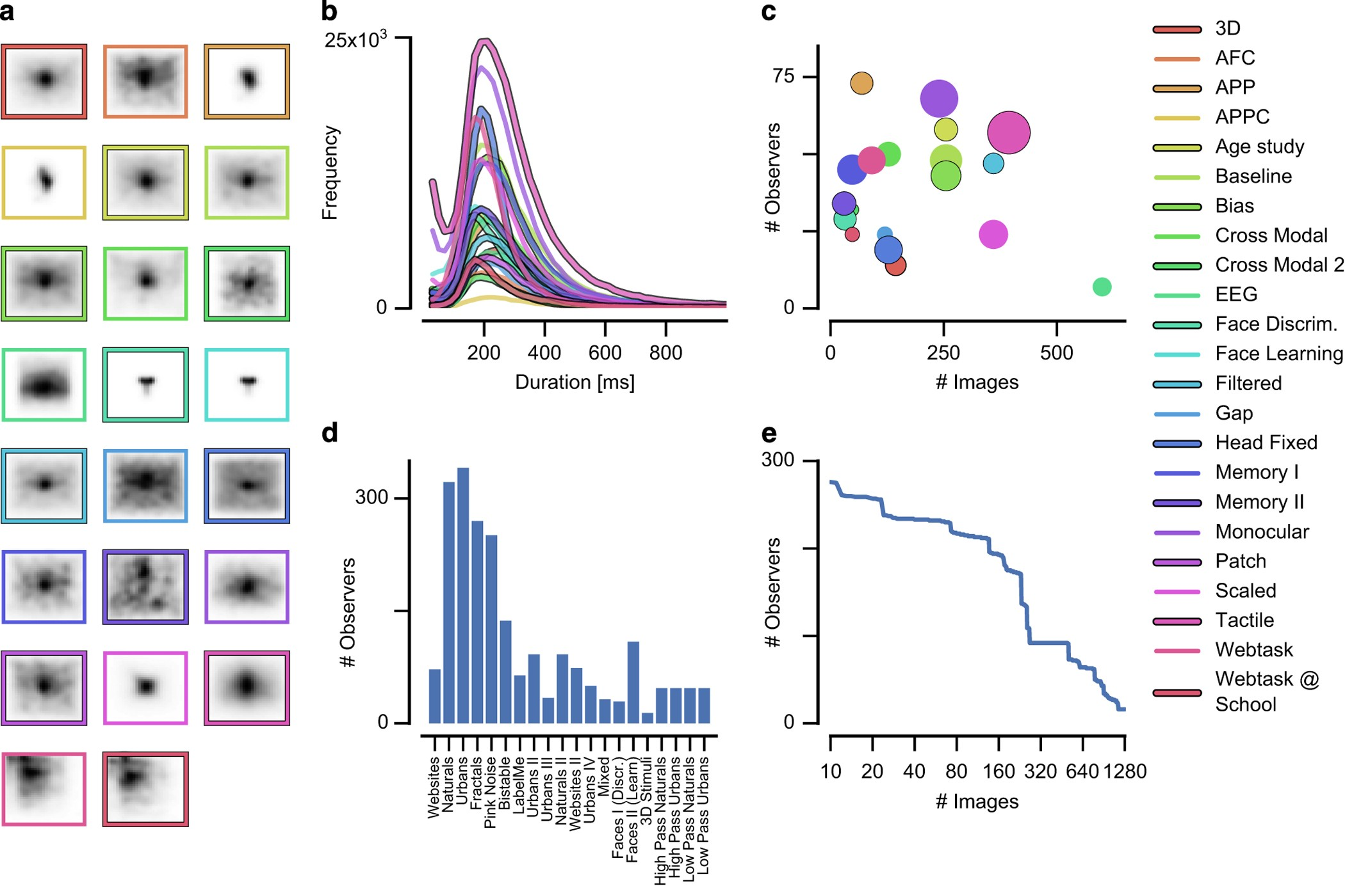

Slide 14


